Slide 1
大美北外
2015北外网院暑期营地活动作品

Slide 2

大白带你游校园
Hi,I am Baymax~
Follow me ☺

Slide 3
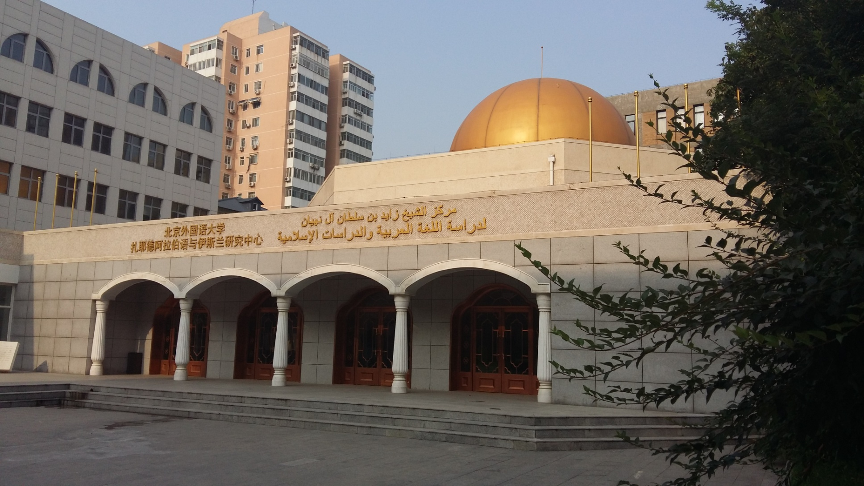
The beautiful Arabic school in the sunshine

Slide 4
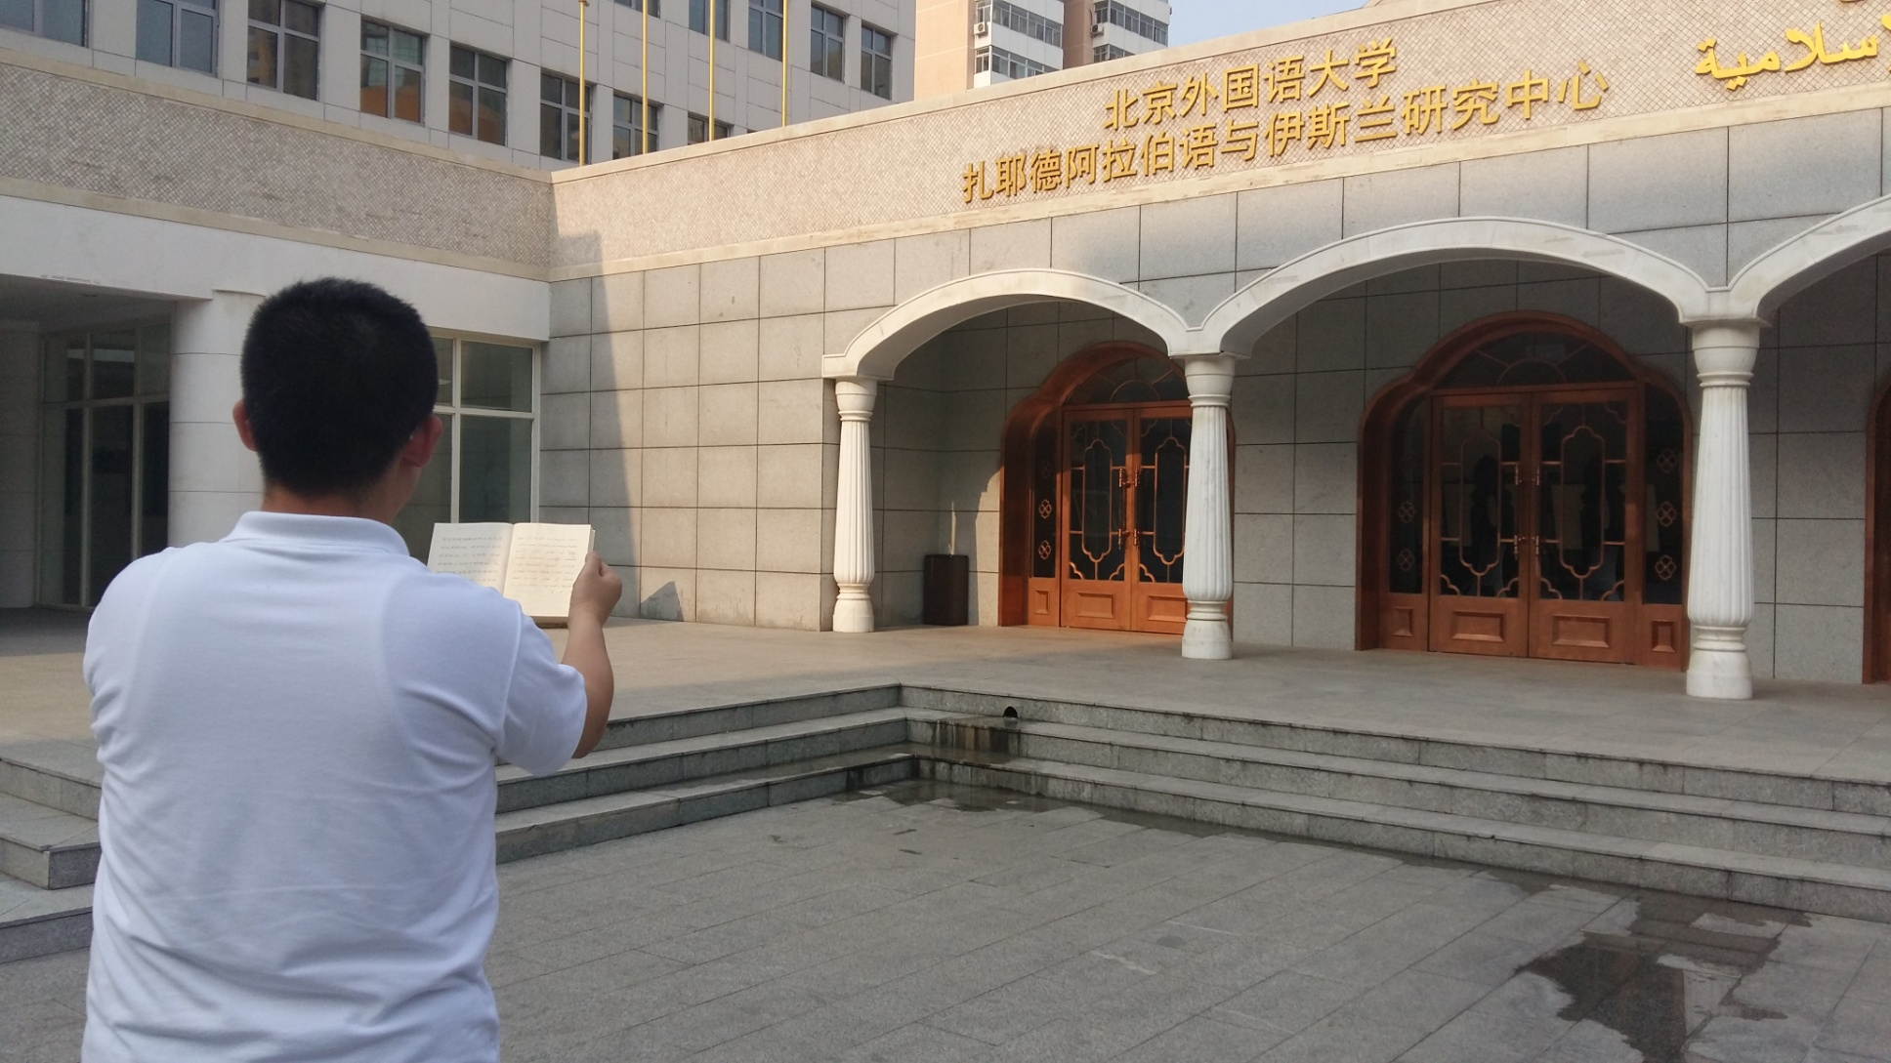
Stand in front of the Arabic school,open the book ,receive the englishment and old wisdom of Arabics

Slide 5
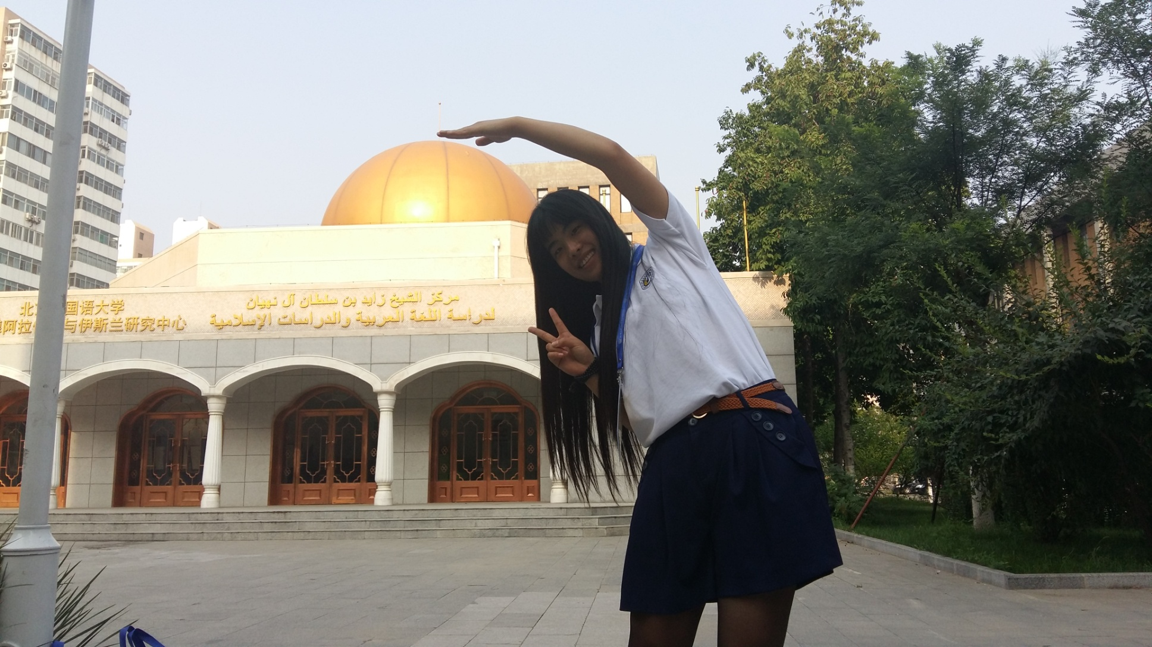
When we touch the top of the building,we touch the knowledge.

Slide 6
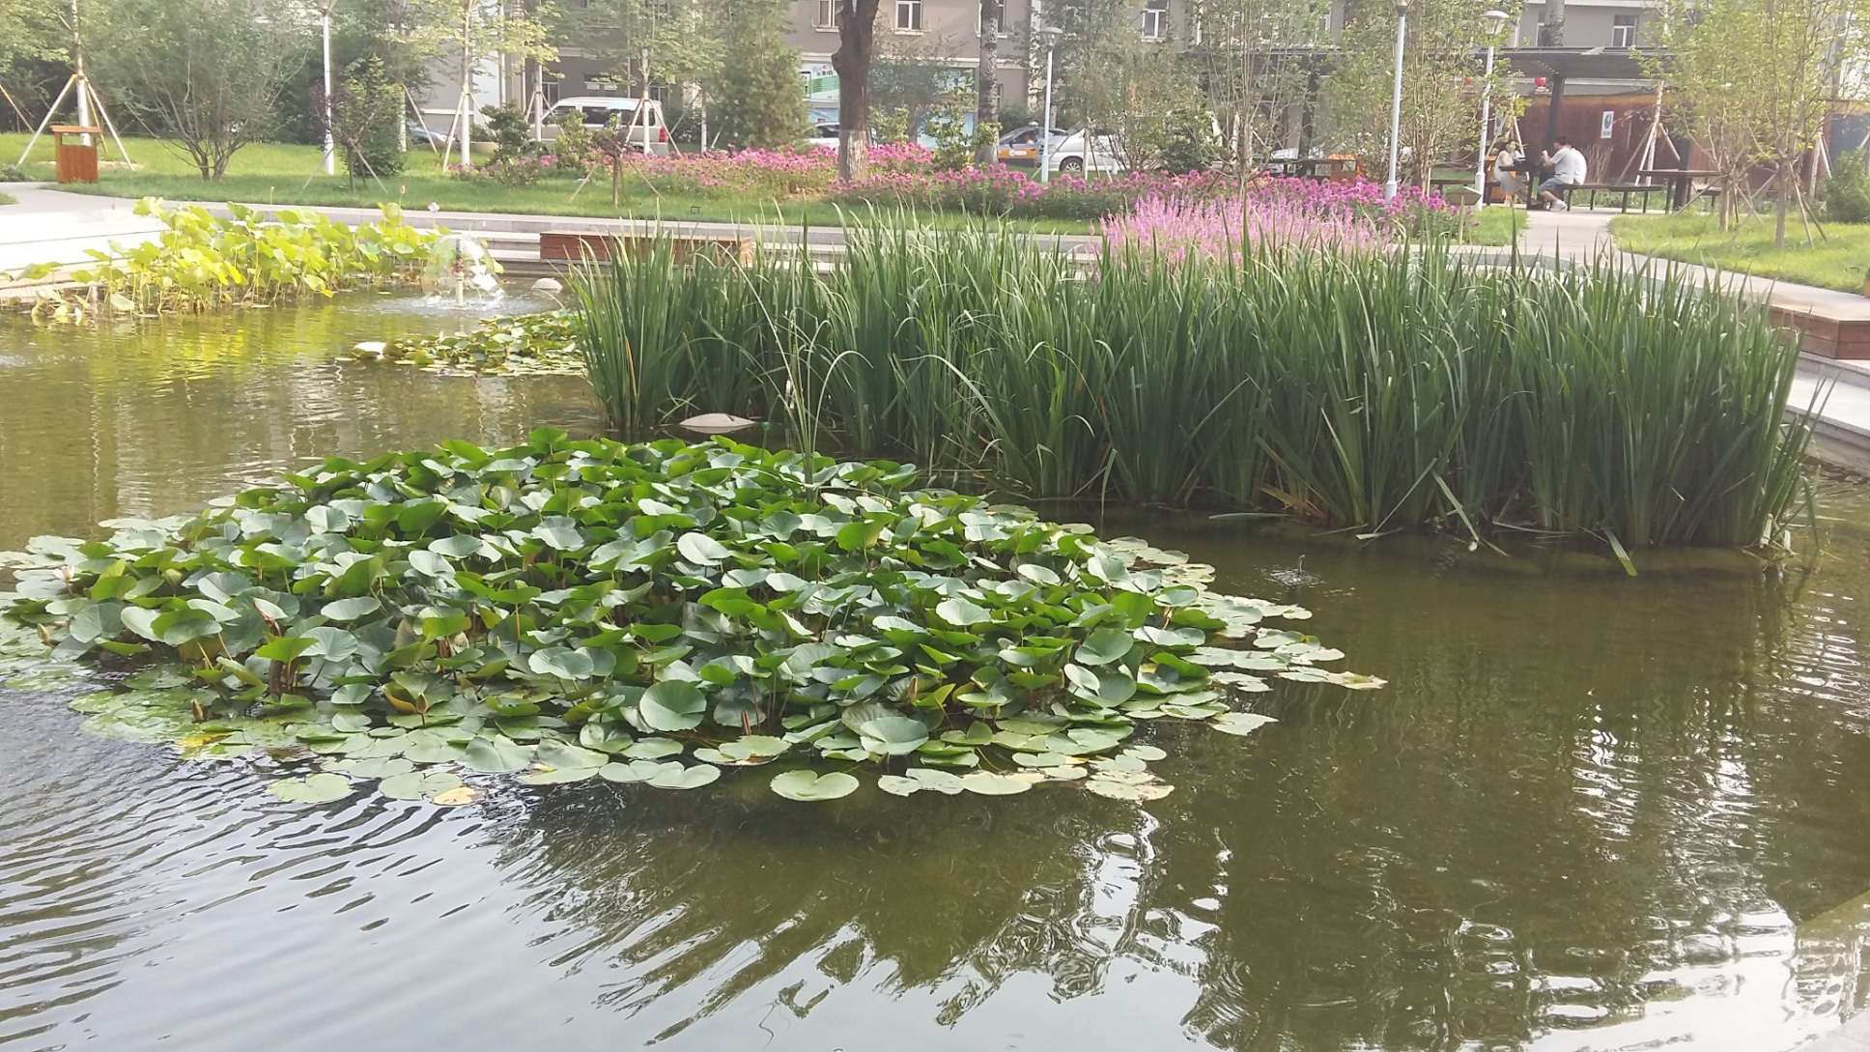
In our campus, there is a beautiful and picturesque lotus pond

Slide 7
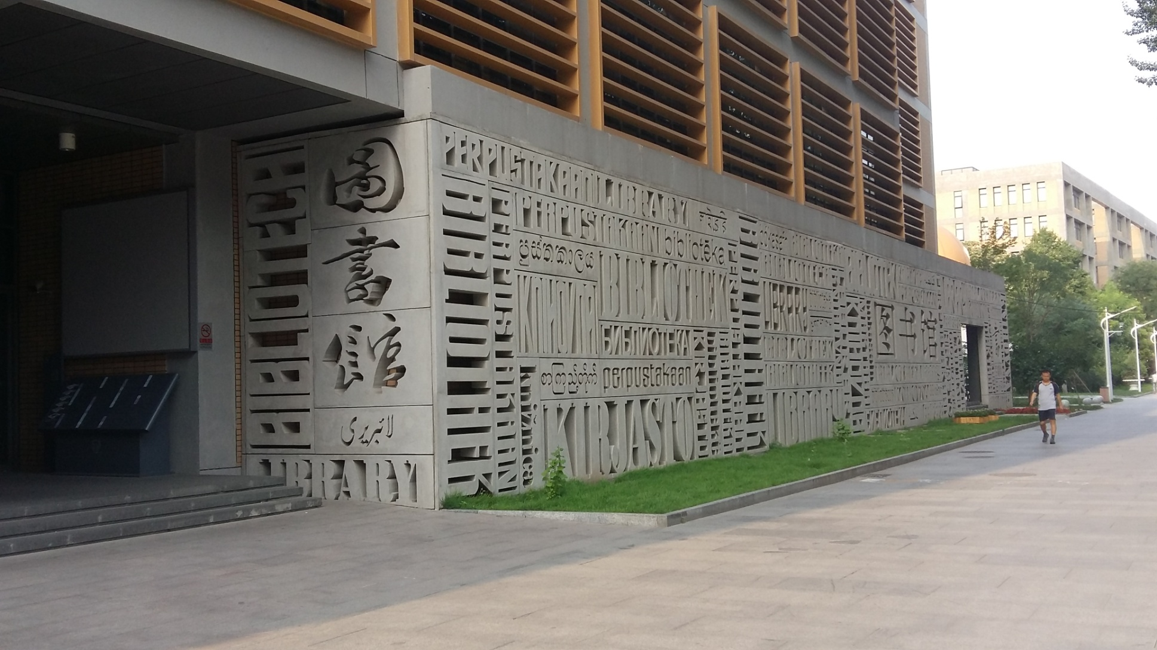
the ocean of knowledge

Slide 8

BFSU’S L symble of liguistic

Slide 9
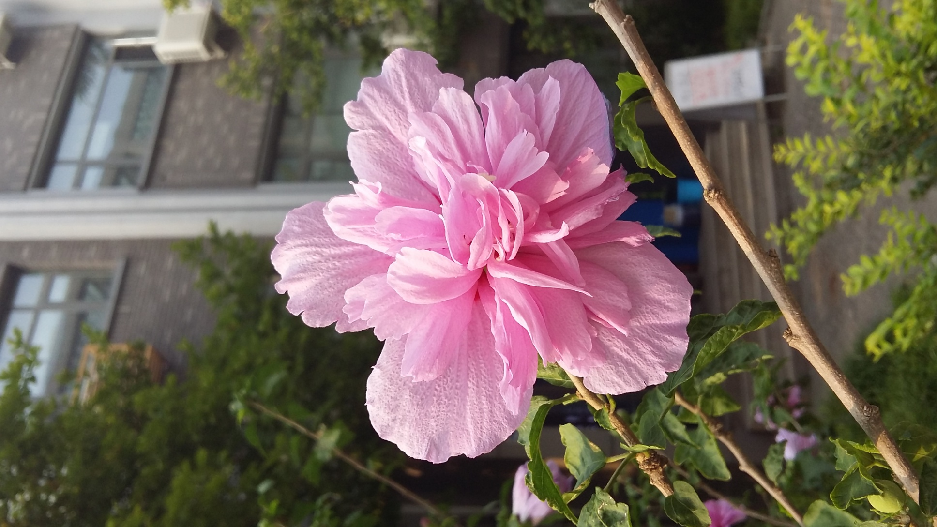
bloom

Slide 10
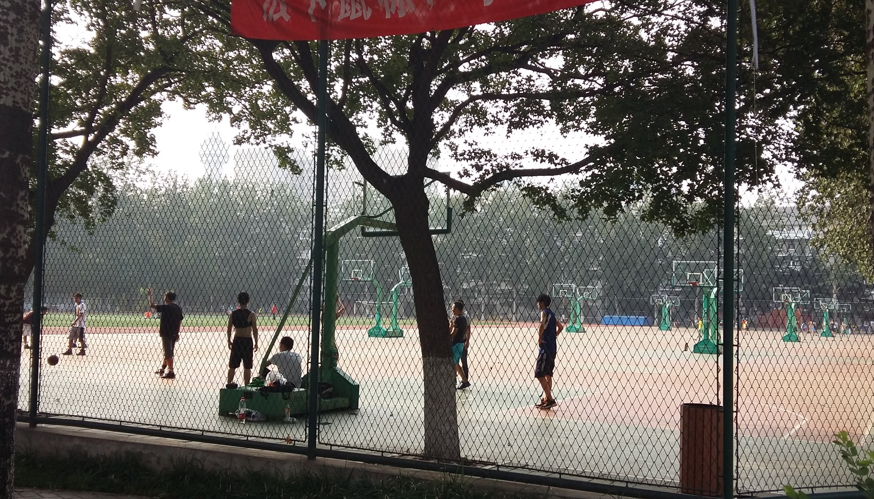
schools' sports grounds

Slide 11
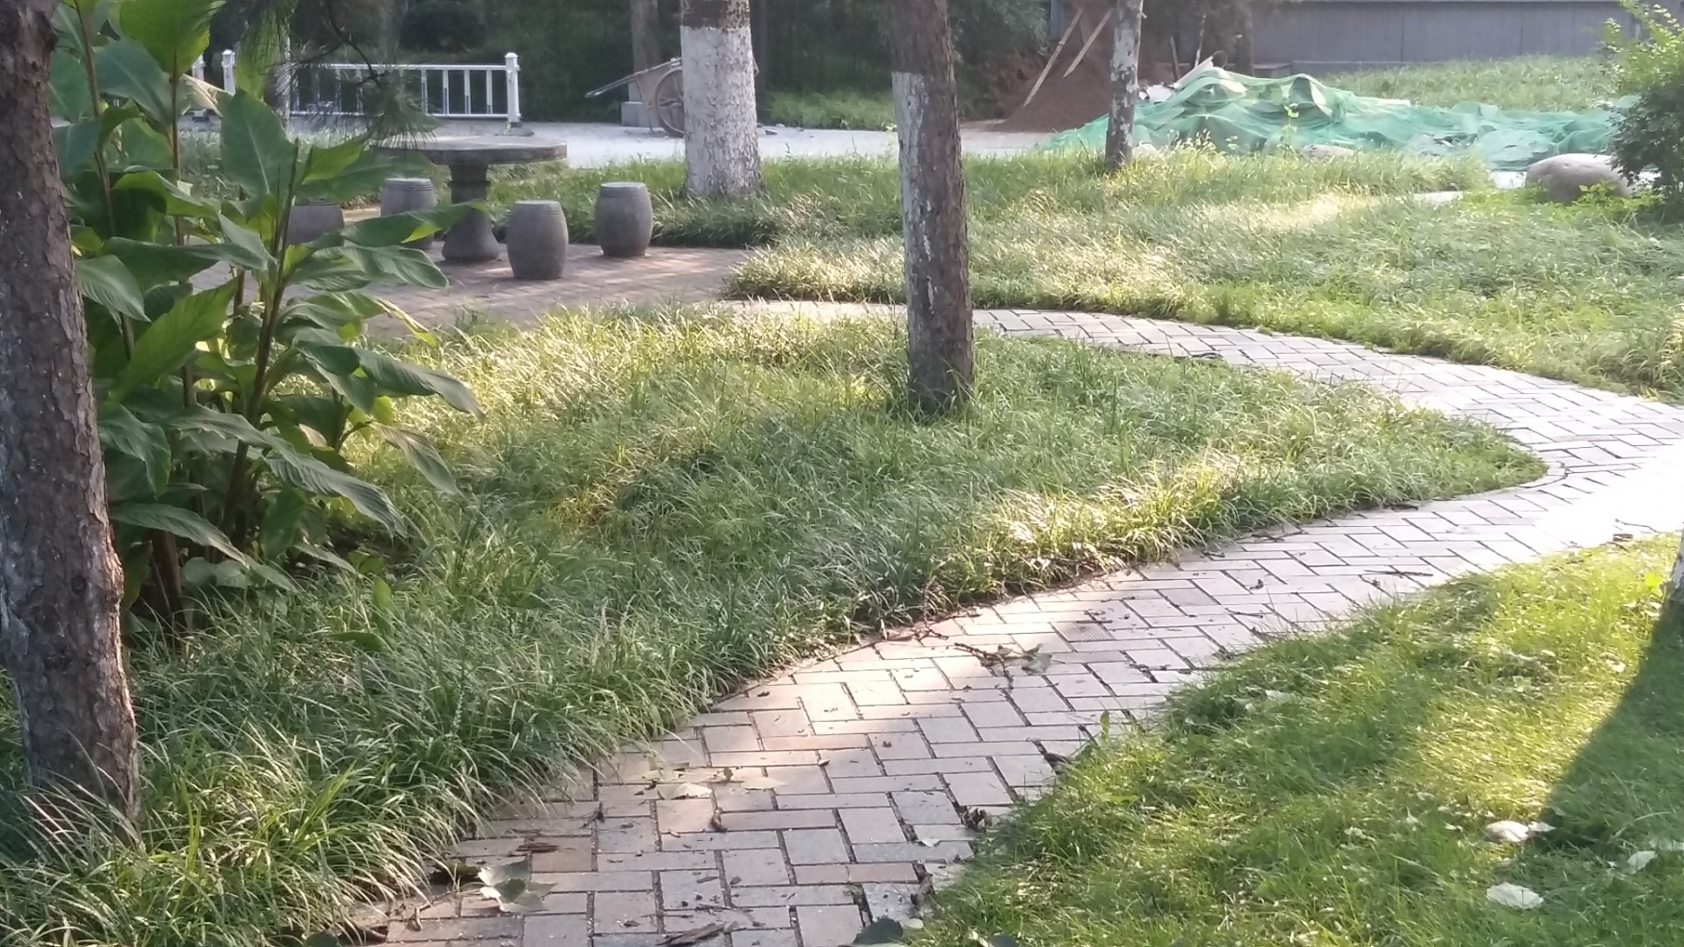
The winding path leads to a secluded quiet place.

Slide 12
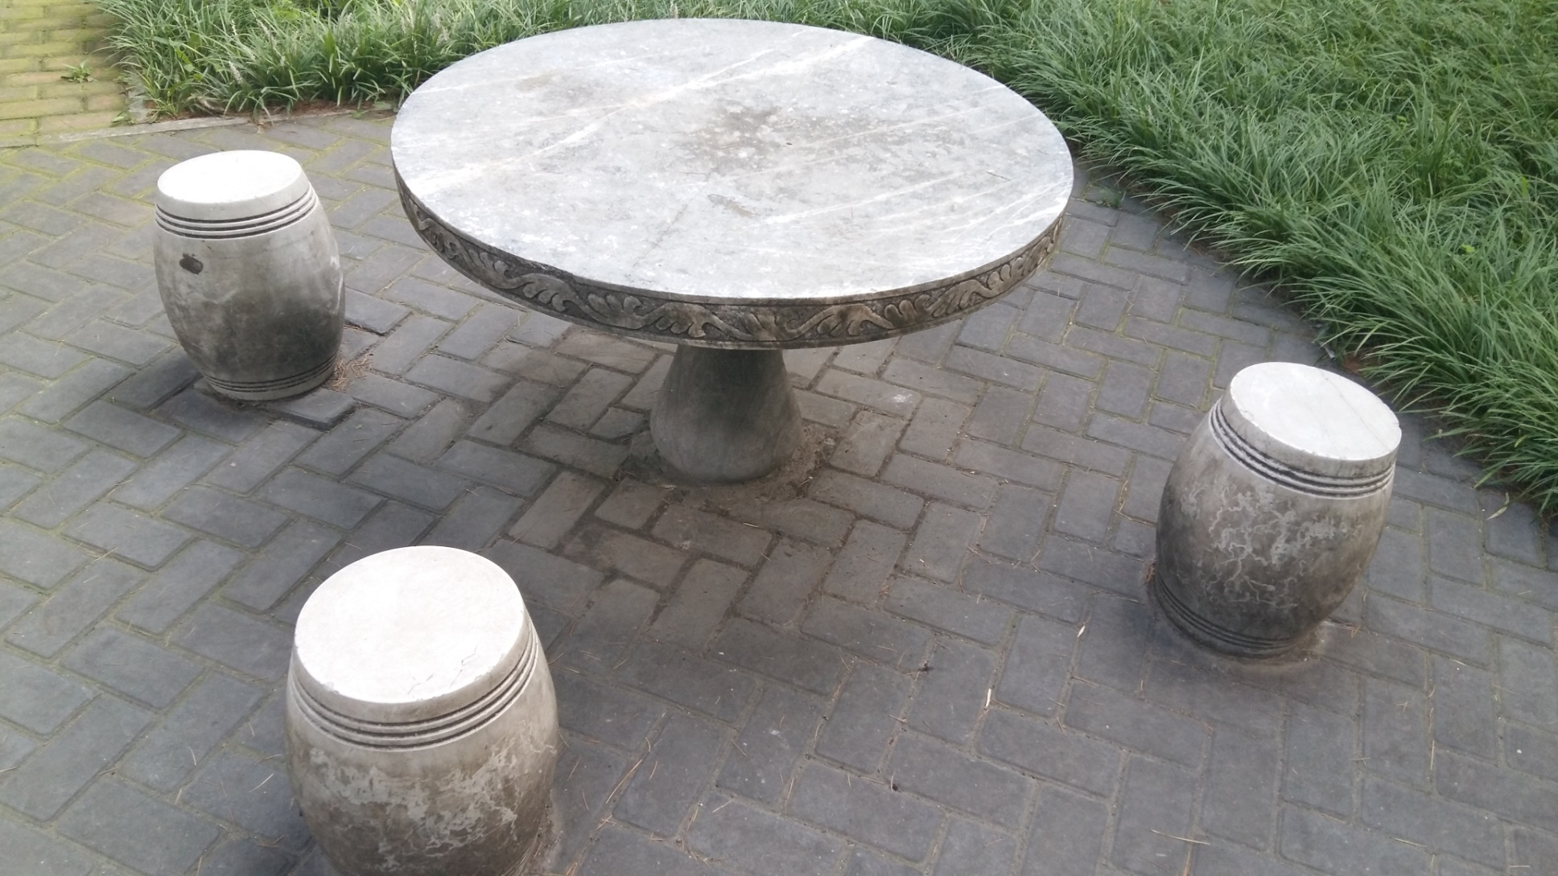
Relax

Slide 13
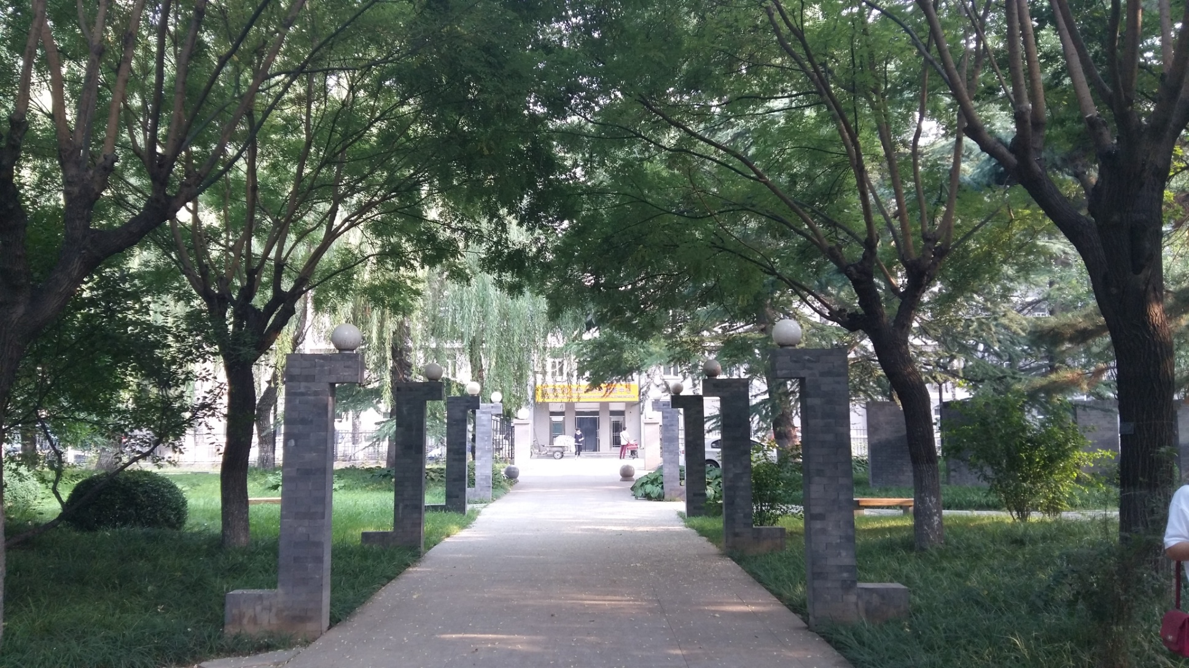
The sunset shed its twilight on the path, which is led to an endless scenary in front of us.

Slide 14
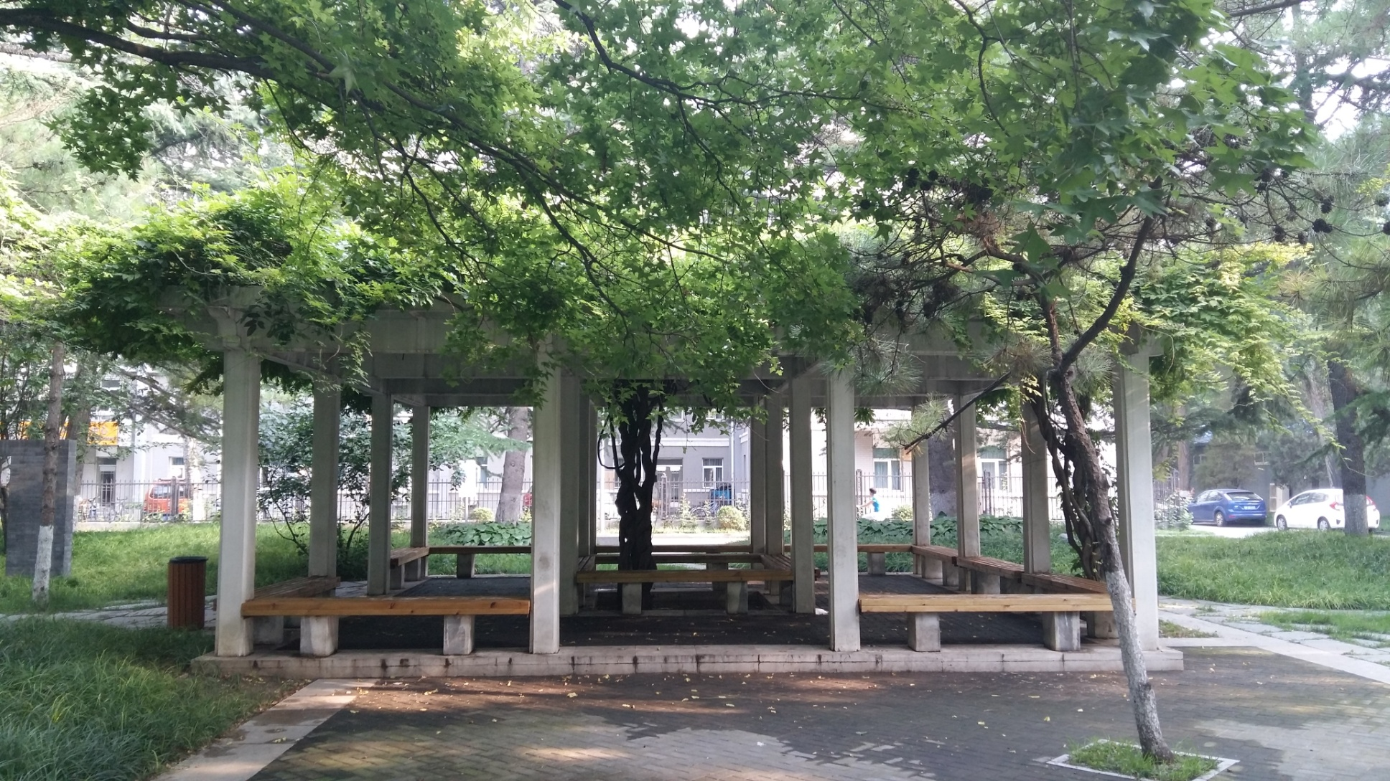
The pavilion is underneath the shade of the tree

Slide 15
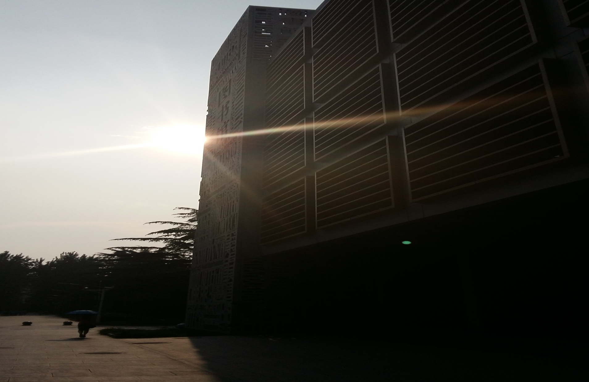
light and shadow

Slide 16
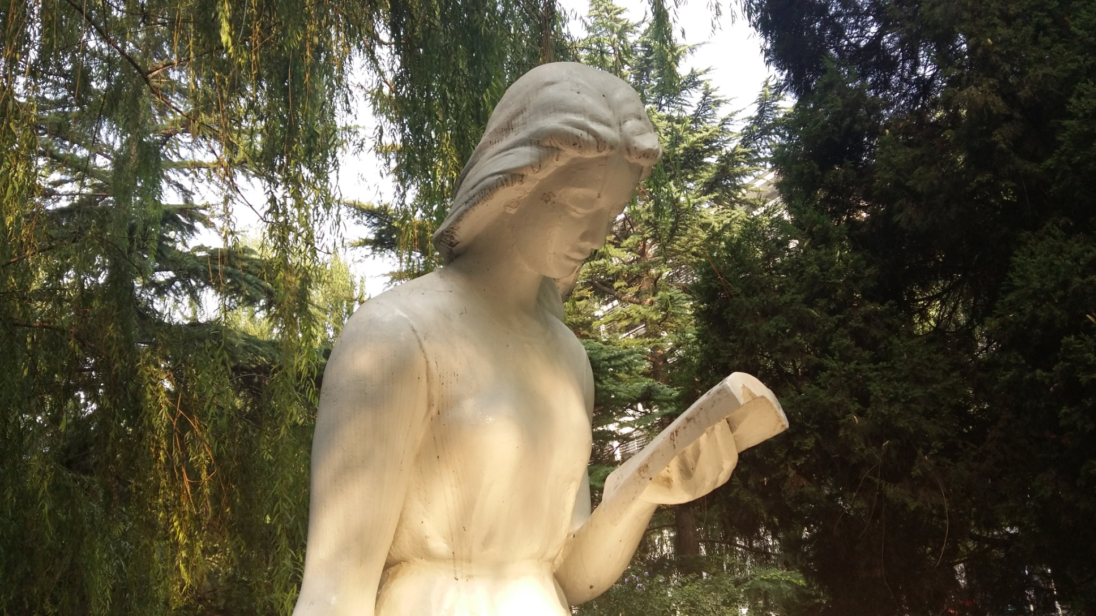
Reading

Slide 17
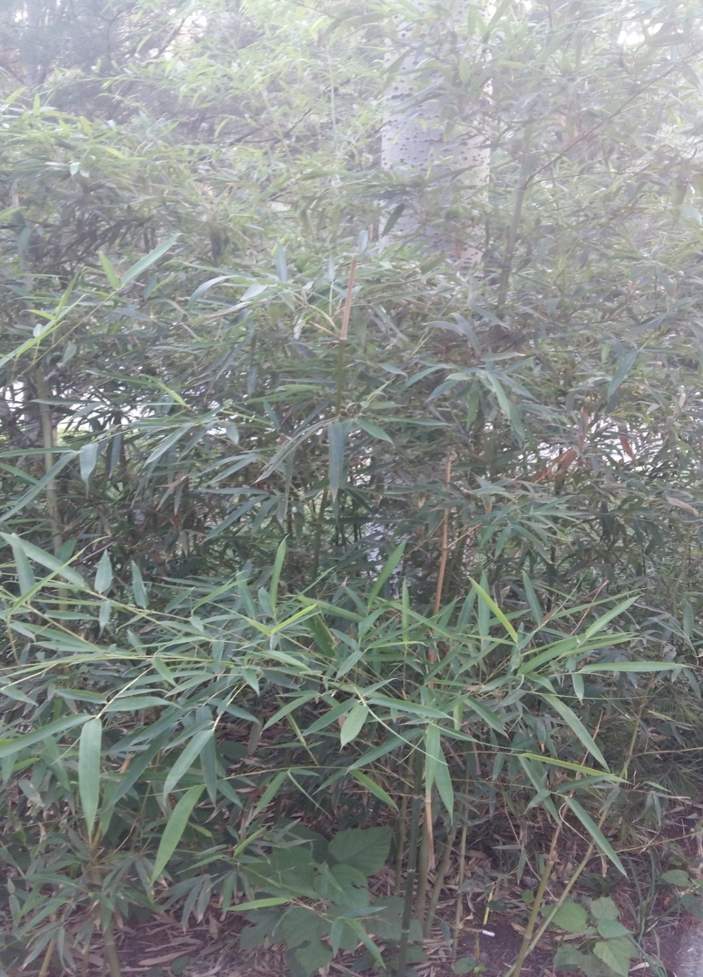
Grow up

Slide 18
The things inspired us, it is usually the true feeling of life. I use my camara to capture the moments and share it with you☺
--任利龙 李艳华

Slide 19
Thank you!

