Slide 1
英语学到什么时候算个头？
Let There Be Light!
By Wen CAO
www.beiwaionline.com
www.beiwaibest.com

Slide 2
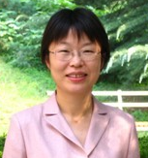
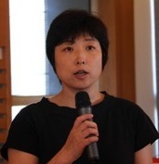
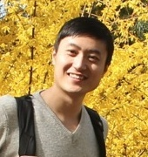
北外与普特第一期合作
规划篇
学术篇
素养篇

Slide 3
400
Cradle of Diplomats 外交官的摇篮。
Wherever a five-starred red flag is flying, there are Beiwai alumni.
凡是有五星红旗飘扬的地方，就有北外人的身影。
54

Slide 4
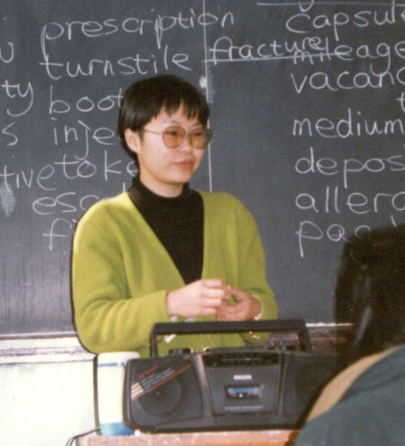
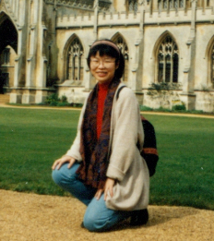
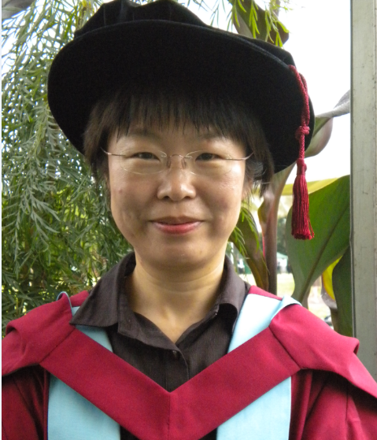
My Growing Path
BA
MA
PhD
1988
1995
2010

Slide 5
Q1: What is your path like?

Slide 6
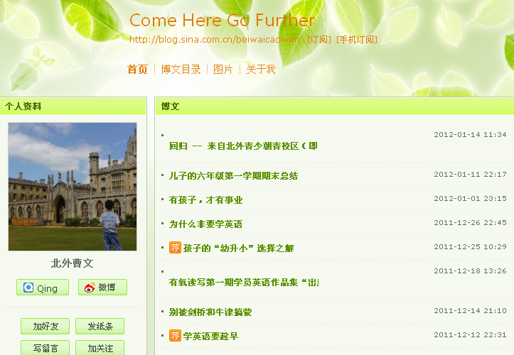

Slide 7
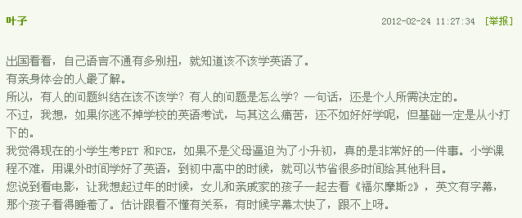

Slide 8
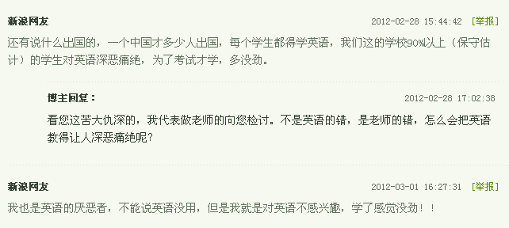
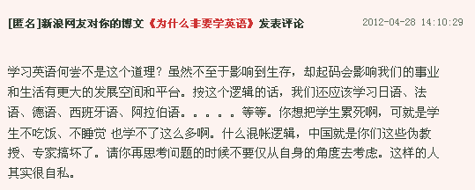

Slide 9
Q2: Why do you learn English?

Slide 10
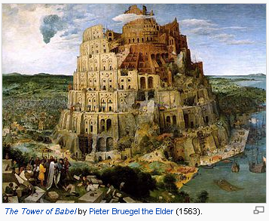
God said, "They are one people and have one language, and nothing will be withholden from them which they purpose to do."

Slide 11
Where Is the Light?
1
Where are you?
2
Where are you going?
3
How can you get there?

Slide 12
Where Is the Light?
1
Where are you?
2
Where are you going?
3
How can you get there?

Slide 13
Benchmarks
Length: “我学了八年英语了。”
Vocabulary:“我有两万词汇量 。”
Skills：“我听特棒，说和读也可以，但怵写。”
Content: “跟老外聊天行，用英语谈判不成。”
Certificate: “我一年级就通过了大学英语四级。”
Notes:
13

Slide 14
Q3: What is your benchmark?

Slide 15
Linguistics/English Language Teaching/Target country studies/Literature/Translation and interpretation …
English for Specific Purpose
English for Academic Purpose
General English
Understanding of the language and culture

Slide 16
Daily Settings
GE
Thank you!

Slide 17
University or Research Settings
EAP
… which is much appreciated.

Slide 18
Workplace Settings
ESP
… The Chinese currency appreciated 2.8% against the US dollar.

Slide 19
Cultural Settings
Culture
Where do you live?

Slide 20
Q4: Where are you now?

Slide 21
eclass.beiwaibest.com
测评系统借鉴了国际著名英语词汇研究和教学专家Paul Nation教授的相关研究成果，运用词汇量这个重要参数对英语水平进行评估，权威可靠。

Slide 22
Where Is the Light?
1
Where are you?
2
Where are you going?
3
How can you get there?

Slide 23
Further education
Work opportunities
Leisure activities
Notes:
23

Slide 24
Domestic English Certificates
CET （大学英语四、六级）
TEM （高校英语专业四、八级）
PETS （公共英语等级证书）
BETS （北京英语等级证书）
CATTI （中国翻译专业资格水平考试）
NAETI （中国外语翻译证书考试）
SIA （上海市外语口译证书考试）
FECT （金融专业英语证书）
Notes:
24

Slide 25
International English Certificates
General English
English for Specific Purpose
YLE Young learner English
KET Key English Test
PET Preliminary English Test
FCE for schools First Certificate in English for schools
BEC 剑桥商务英语
BULATS 博思职业外语水平测试
ICFE 剑桥国际财经英语证书
ILEC 剑桥法律英语国际证书
TOEIC 美国托业（国际交流英语测评）
English for Academic Purpose
IELTS 雅思 / TOEFL 托福/PTE培生FCE First Certificate in English
CAE Certificate in Advanced English
CPE Certificate of Proficiency in English
Teaching Qualifications
TKT 剑桥语言教学能力证书
CELTA/DELTA /TESOL/TEFL

Slide 26
剑
少
剑
五
剑
五
商
务
法
律
财
经
博
思
雅
思

Slide 27
Q5: What is your short-term and long-term goal?

Slide 28
Where Is the Light?
1
Where are you?
2
Where are you going?
3
How can you get there?

Slide 29
2. Conduct an Action Research
学生：老师，我英语听力特差。
老师：怎么差了？
学生：听不懂。
老师：怎么听不懂了？
学生：…【如果你是他，你怎么回答？】

Slide 30
Identify the Problem
Step 1
What makes your comprehension difficult?
Example 1: Who is going to peruse this?
Example 2: He was taken to the cleaner’s.
Example 3: The dessert tastes wonderful. ( /’de sε:t/ /di’s ε:t/)

Slide 31
Identify the Problem
Step 1
Example 4: I’ll meet you at lunch hour.
Example 5: You understand and comprehend everything but fail to provide a correct answer in the exercise. (eg. multiple-choice questions, blank-filling exercise)

Slide 32
Example 6
Step 1
Identify the Problem
出租车司机开车太野，于是我和他有了这段对话：
我：你开得太快了，几分了？
司机：没分。
我：有人呀？
司机：没人。
我：那怎么可能。
司机：真的，头上还有星儿呢。

Slide 33
Analyze the Problem
Step 2
You fail to understand a piece of listening because:
You have new words or phrases in it. (Vocabulary problem)
You have been mispronouncing words so that you can not establish meanings. (Pronunciation problem)
You miss out the linkage. (Pronunciation problem)

Slide 34
Analyze the Problem
Step 2
You misunderstand the questions or you can’t read fast. (Reading problem)
You don’t know how to give a summary comment to fill in the blank. (Writing problem)
You lack background information. (Context problem)

Slide 35
Step 3
Make an Action Plan
For this month, I will analyze all my listening performances to identify my problem.
 | L1 | L2 | L3 | … | Ln
P1
P2
P3
…
Pn

Slide 36
Design Practical Activities
Step 4
Vocabulary problem (words/phrases)
Pronunciation problem (individual word pronunciation / mispronunciation / linkage)
Reading comprehension problem (vocabulary / grammar / culture)
Reading speed problem
Writing problem
Background information problem

Slide 37
Evaluate Progress
Step 5
At the completion of Step 4, check my progress by comparing my current performance with my performance recorded in Step 3.
If I made much progress, I will turn to deal with another major problem.
If not, I should keep to my practical activities or try some new ones.

Slide 38
What makes a difference?

Slide 39
3. Study in an Educationalized System
A Time Scale
A Plan
A Place
A coach
Partners
Discipline
A Goal
Activities
Test

Slide 40
Q6: What are the three key concepts for obtaining your goal?

Slide 41
Do You See the Light?
1
Know where I am.
2
Know where I am going.
3
Know how I can get there.

Slide 42
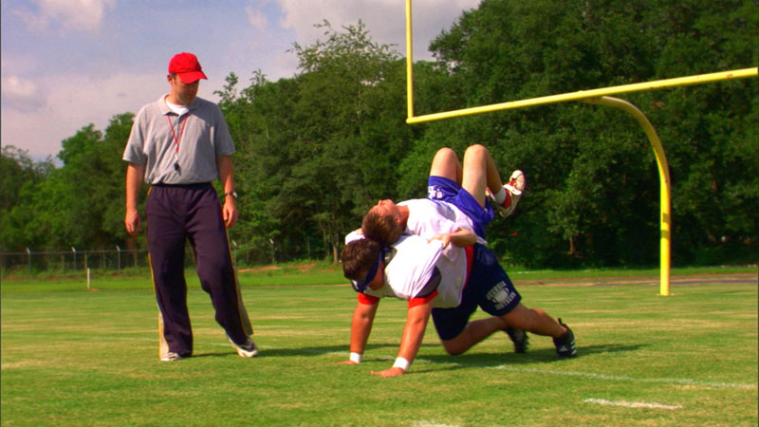
Facing the Giants

Slide 43
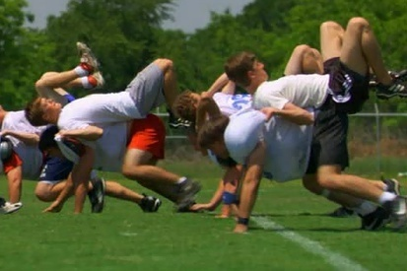
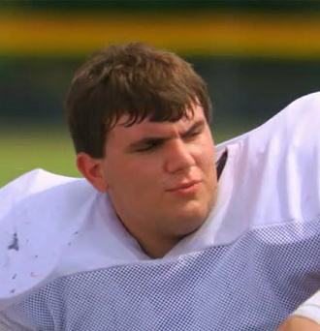
How Many Yards?
10
30
50
A Football Team
Brock,
the captain
The
coach
Listen and note down the phrases the coach said to encourage Brock to go on.

Slide 44
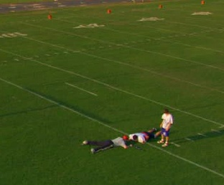
Come on!
You are gonna give me your best!
Good strength!
Don’t quit!
Good effort!
That’s it!
There you go!
You can give me more!
Don’t stop!
Keep going/moving/driving
You’ve got nothing left!
100!!
I wanna everything you’ve got!
Don’t you give up on me!

Slide 45
English is an asset. We are investors.
Our time
Better jobs
Our effort
Better education
will be paid off
Our money
Better life
Our love
Better future

Slide 46
北外曹文
我的博客：blog.sina.com.cn/beiwaicaowen
我的微博：weibo.com/beiwaicaowen

