Slide 1
去英国还是美国的名校
-- 你想好了吗？
Universities
UK vs. USA
By Jiewen Luo
www.beiwaionline.com
www.beiwaibest.com

Slide 2
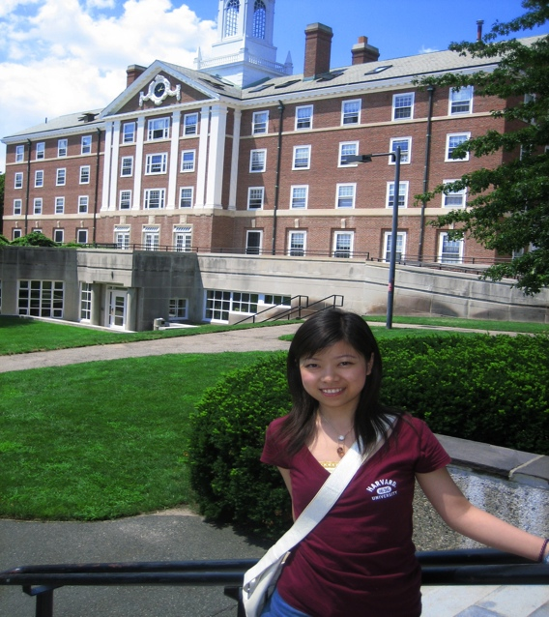

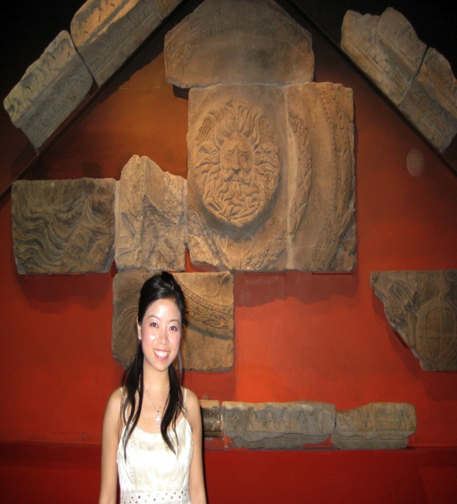
My Personal Experience
in UK and USA
2007
BATH
2008
HARVARD
2009
LONDON

Slide 3
Dissertation
Individual assignment VS Group work
Discussing or Not
Exam
Mark

Slide 4

1.1 Individual assignment
VS Group work

Slide 5
1.2 Discussing or Not?

Slide 6

1.4 EXAM？EXAM！

Slide 7


1.3 MARK!

Slide 8
2. In Class
Number of Students
Ethnic Group
You and Your Professors
Courses

Slide 9


2.1 Number of Students

Slide 10

2.2 Ethnic Group

Slide 11
2.2 You and Your Professors

Slide 12
2.3 Courses
Language Course
Compulsory Course
Optional Course
Credits
www.ratemyprofessors.com

Slide 13
FOOD!

Slide 14

3.1 Harvard University

Slide 15
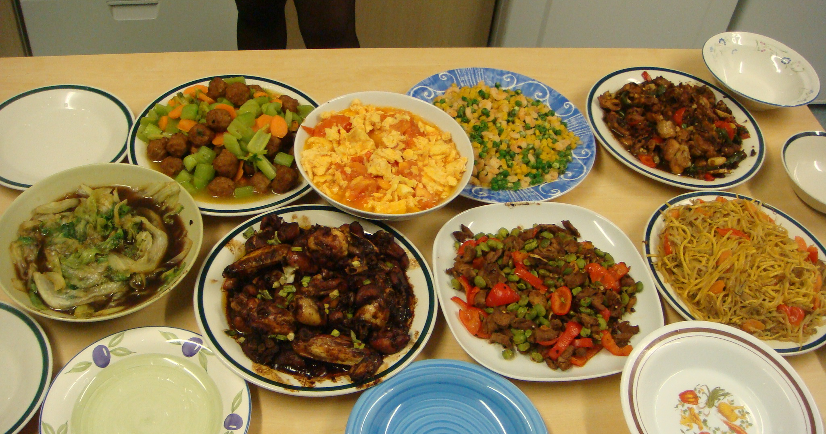
3.2 University of Bath

Slide 16
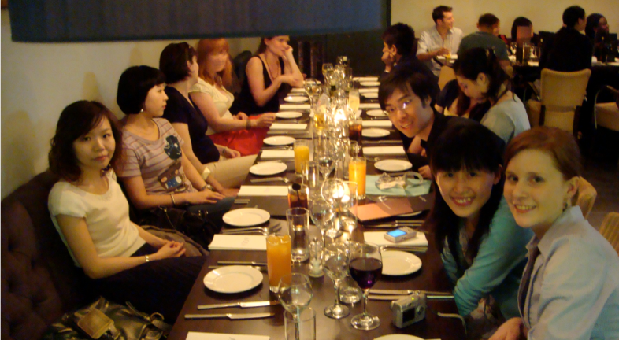

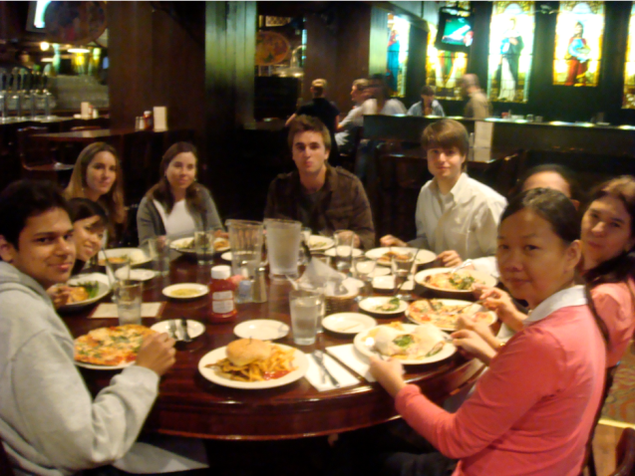
3.3 Party

Slide 17

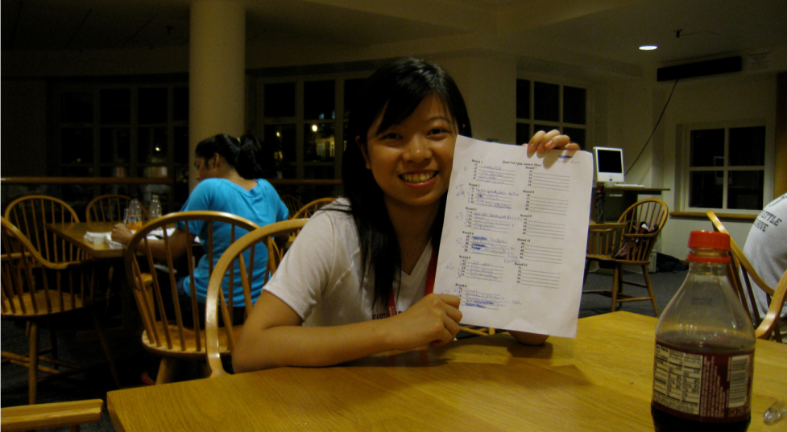
Study Break

Slide 18

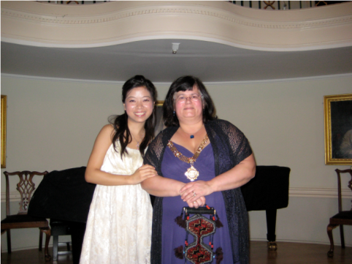
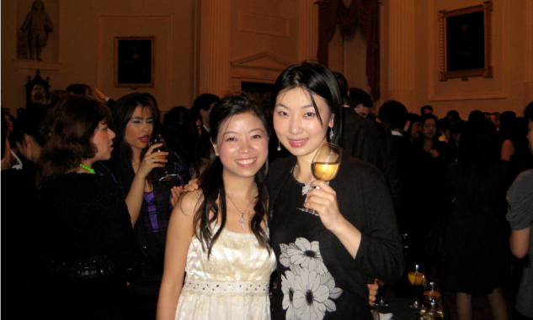
Banquet

Slide 19

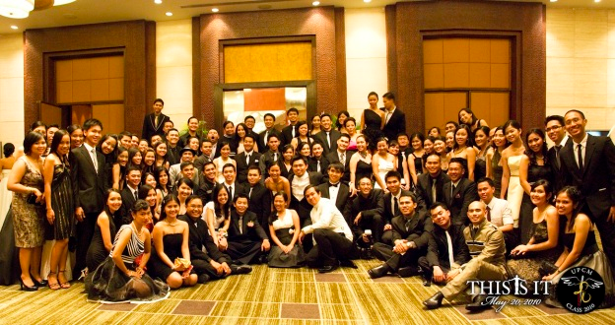
Ball

Slide 20
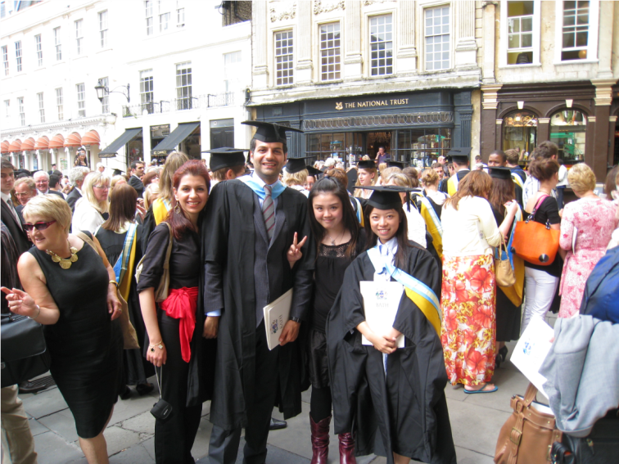
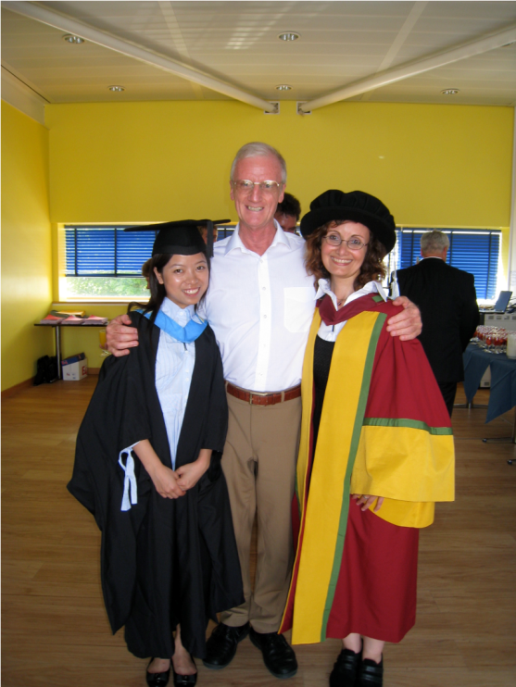
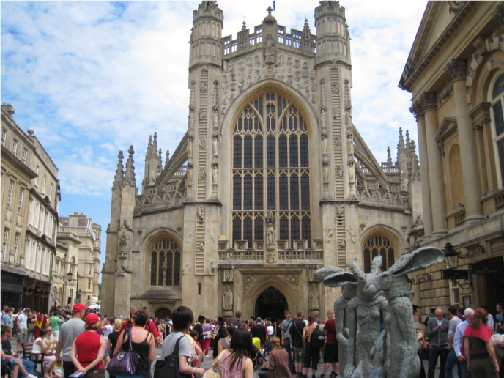
Celebration

Slide 21
Your Choice
Time
Application Procedure
Ranking
Campus Life
Working opportunity

Slide 22
4.1 TIME
3-years
UK
4-years
USA
Undergraduate Studies
1-year
UK
2-years
USA
Graduate Studies

Slide 23
4.2 Application Procedure
Academic background
Personal Statement
Reference
Essay
IELTS/ TOEFL/ SAT/ GRE/GMAT…

Slide 24
4.3 Ranking
Public Universities
Public VS. Private
University VS. College
UK
USA

Slide 25
4.4 Campus Life
Lecture
Seminar
Social activities
Student union

Slide 26
4.5 Working opportunity
Part-time Job
Working opportunities in summer holidays
Internship
Working visa

Slide 27


测试推荐：www.beiwaibest.com

Slide 28
ENJOY YOUR LIFE!
北外罗洁文
我的微博：http://weibo.com/jiewenna

